Slide 1
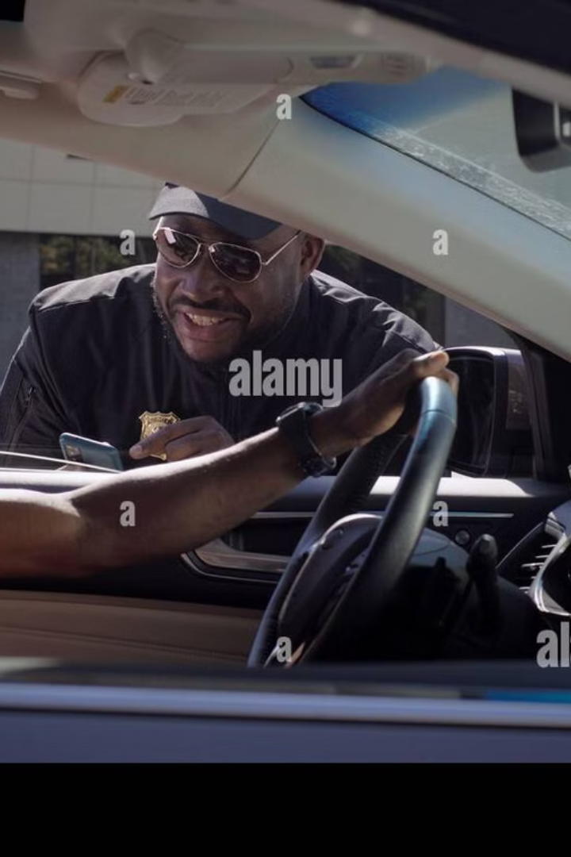
Police Examination Process: Streamlining Driving License Management
This presentation outlines the development of a digitalized system for managing police examinations for driving licenses.

Slide 2
Project Overview and Scope
Project Aim
Process Focus
Key Features
To create a streamlined, digital system to support driving license applications.
Covers all stages from registration to examination and result notification.
Automation, data accuracy, enhanced protection, and minimized manual handling.

Slide 3
Phase 2: Business Process Modelling
1
Application Submission
Applicants submit their applications online.
2
Document Verification
Police officers verify submitted documents.
3
Exam Scheduling
Applicants are scheduled for their driving exams.
4
Result Recording
Examination centers record test results.
5
License Issuance
Successful applicants receive their driving licenses.

Slide 4
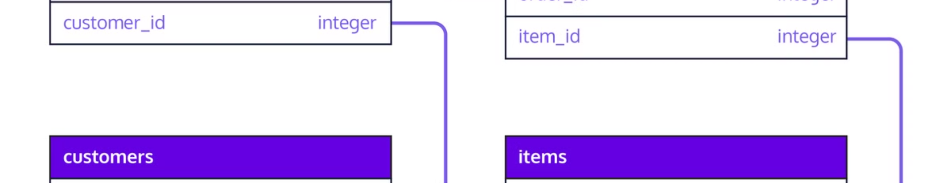
Phase 3: Logical Model Design
Applicant Table
Application Table
Stores personal details of applicants.
Tracks the status of applications.
Examination Schedule Table
Test Table
Links applications to examination centers and notifications.
Records test details, results, and examiner comments.

Slide 5
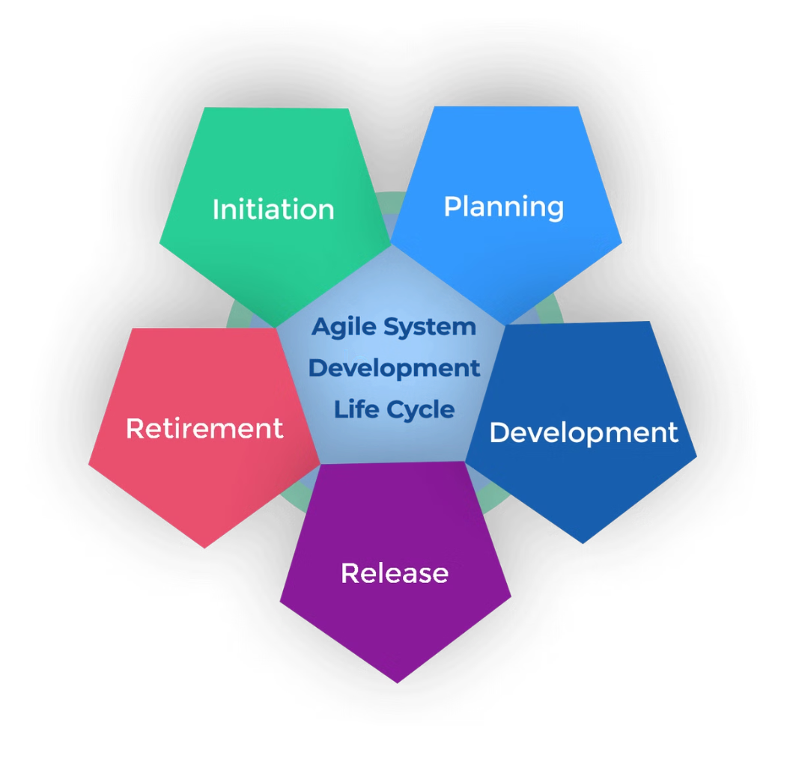



Phases 4, 5 & 6: System Development
Database Design
Defines tables and relationships.
Transaction Operations
Includes insert, retrieval, update, and delete operations.
Results and Reports
Generate insights on applicant details, test results, and pass/fail rates.

Slide 6





Phase 7: Driving License Management System
1
Applicant Management
2
Examination Scheduling
3
Test Results Storage
4
License Issuance
5
Notifications

Slide 7

Key Features Implemented
Triggers
Cursors
Automate workflows and enforce business rules.
Process row-by-row operations efficiently.
Functions
Packages
Ensure reusable and modular programming.
Organize related database objects for better maintenance.

Slide 8

Thank You
We appreciate your time.

